Slide 1
Outsiders Presentation:
Ponyboy Character Analysis.
Mostly by Trevor Carlson
A nice chunk of it by Ashton Parker Johnson
Very little by Christopher Alreid

Slide 2
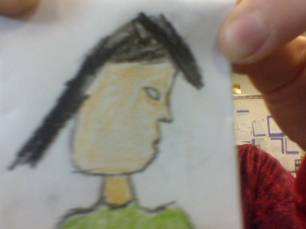
Portrait of Ponyboy Curtis

Slide 3
Important Information on Ponyboy!
̴ Ponyboy Curtis is a member of the Greasers, a gang that is made up of middle class members, which is not a hood but is more like a brotherhood.
̴ He is the younger brother of Sodapop, and Darry Curtis.
̴ Ponyboy is the only person out of the seven greasers that we’re introduced to in the beginning that likes movies, and books.
̴ He is often treated like a 6-year old by his eldest brother Darry Curtis.
̴ Ponyboy is the age of 14 at the start.

Slide 4
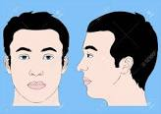
Physical Traits
̴ Ponyboy has green eyes with a dash of gray.
̴ He has light brown almost red hair, and has a scar on the side of his head from getting cut by a Soc.
̴ He is good of build and is 14 years of age.

Slide 5
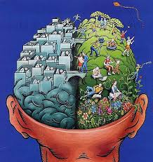
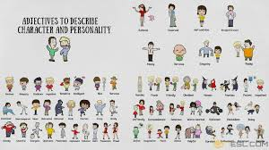
Character Traits
̴ Ponyboy likes to watch movies, and read books.
̴ He is very intelligent, but he often doesn’t use his head outside of school.
̴ Ponyboy has feelings of not quite belonging in places such as school.
̴ He is not that interested in girls at the beginning.
POny PO

